Slide 1
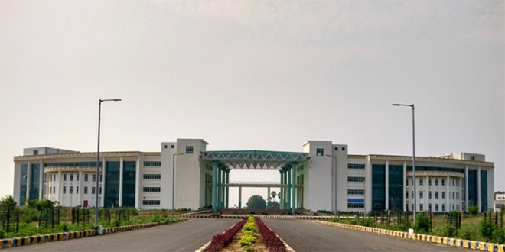

Big Data Analytics
Dr. Rajiv Misra
Associate Professor
Dept. of Computer Science & Engg.
Indian Institute of Technology Patna
rajivm@iitp.ac.in
Big Data Analytics
FDP

Slide 2
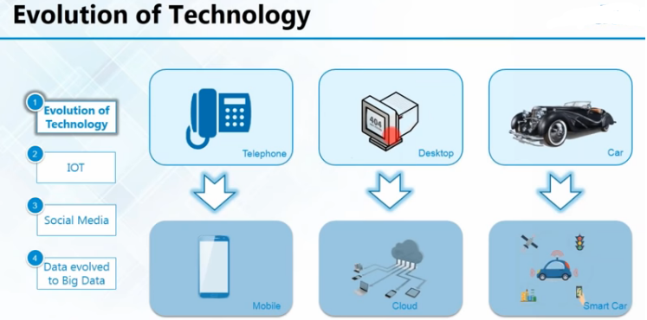

Slide 3
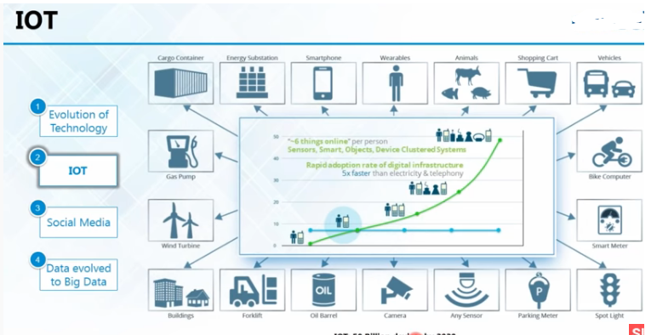

Slide 4
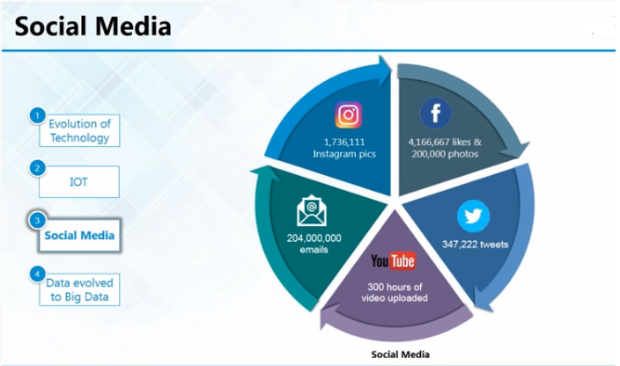

Slide 5
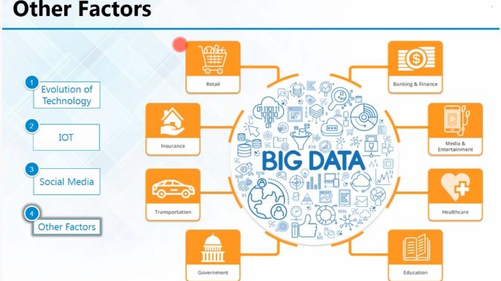

Slide 6
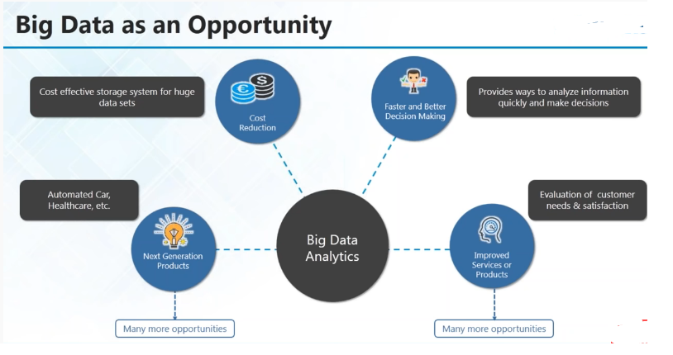

Slide 7
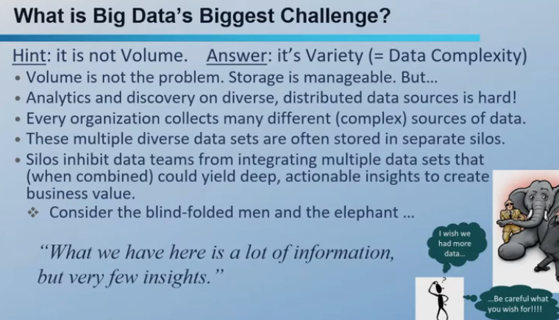

Slide 8
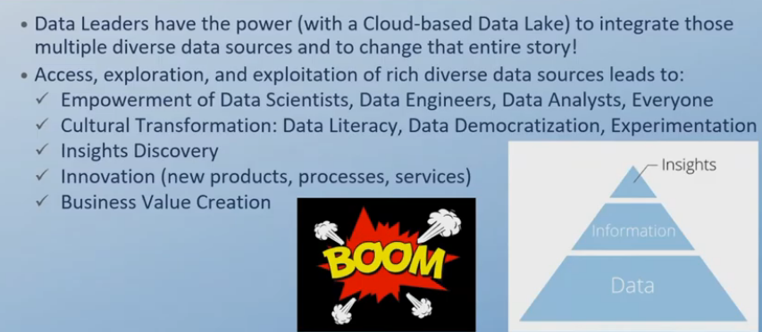

Slide 9
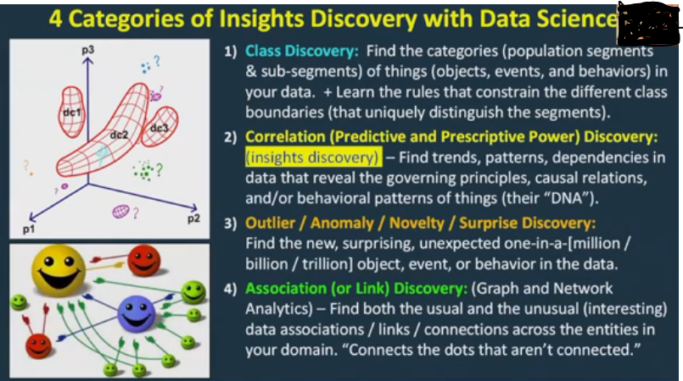

Slide 10
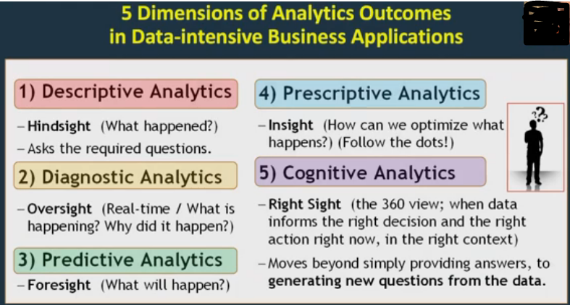

Slide 11
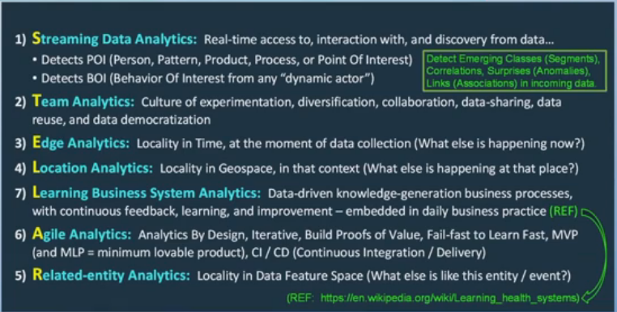

Slide 12
What is Big Data?
Big data is a collection of data sets so large and
complex that it becomes difficult to process using
traditional relational database management systems
Big Data Analytics
FDP
Big Data Computing-A practical approach

Slide 13
What’s making so much data?
ubiquitous computing
more people carrying data-generating devices (mobile phones with facebook, gps, cameras, etc.)
Big Data Analytics
FDP

Slide 14





Source of Data Generation
12+ TBs of tweet data every day
4.6 billion camera phones world wide
30 billion RFID tags today (1.3B in 2005)
100s of millions of GPS enabled devices sold annually
? TBs of data every day
2+ billion people on the Web by end 2011
25+ TBs of log data every day
76 million smart meters in 2009… 200M by 2014
Big Data Analytics
FDP

Slide 15
Where is the problem?
Traditional RDBMS queries isn't sufficient to get useful information out of the huge volume of data
To search it with traditional tools to find out if a particular topic was trending would take so long that the result would be meaningless by the time it was computed.
Big Data come up with a solution to store this data in novel ways in order to make it more accessible, and also to come up with methods of performing analysis on it.
Big Data Analytics
FDP

Slide 16
Challenges:
Capturing
Storing
Searching
Sharing
Analyzing
Visualization
Big Data Analytics
FDP

Slide 17
IBM considers Big Data(3V’s):
Big data spans four dimensions: Volume, Velocity, Variety.
Volume: Enterprises are awash with ever-growing data of all types, easily amassing terabytes even Petabytes of information.
Turn 12 terabytes of Tweets created each day into improved product sentiment analysis
Convert 350 billion annual meter readings to better predict power consumption
Big Data Analytics
FDP

Slide 18
IBM considers Big Data(3V’s):
Big data spans four dimensions: Volume, Velocity, Variety.
Velocity: Sometimes 2 minutes is too late. For time-sensitive processes such as catching fraud, big data must be used as it streams into your enterprise in order to maximize its value.
Scrutinize 5 million trade events created each day to identify potential fraud
Analyze 500 million daily call detail records in real-time to predict customer churn faster
Big Data Analytics
FDP

Slide 19
IBM considers Big Data(3V’s):
Big data spans four dimensions: Volume, Velocity, Variety.
Variety: Big data is any type of data –
Structured Data (example: tabular data)
Unstructured –text, sensor data, audio, video
Semi Structured : web data, log files
Big Data Analytics
FDP

Slide 20
The 3 Big V’s (+1) (+ N more)
Big 3V’s
Volume
Velocity
Variety
Plus 1
Value
Big Data Analytics
FDP

Slide 21
The 3 Big V’s (+1) (+ N more)
Plus many more
Veracity
Validity
Variability
Viscosity & Volatility
Viability, Venue, Vocabulary, Vagueness, …
Big Data Analytics
FDP

Slide 22
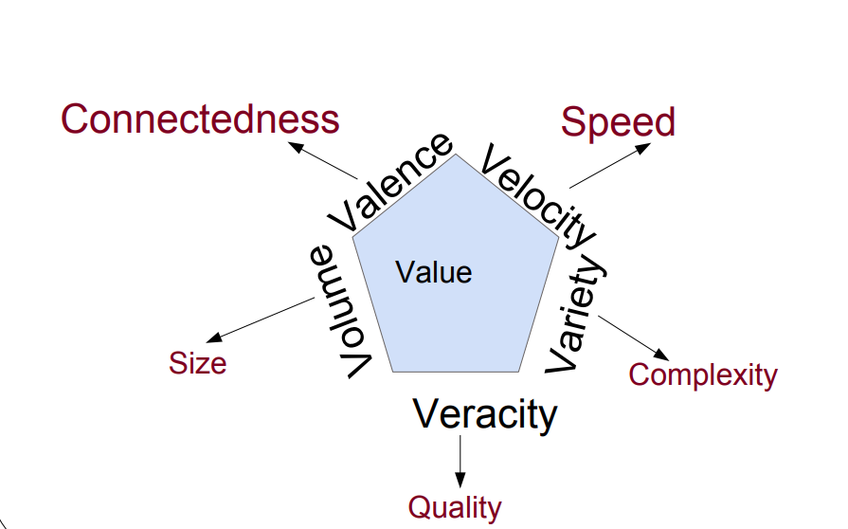
Facts and Figures
Big Data Analytics
FDP

Slide 23
Value
Integrating Data
Reducing data complexity
Increase data availability
Unify your data systems
All 3 above will lead to increased data collaboration -> add value to your big data
Big Data Analytics
FDP

Slide 24
Veracity
Veracity refers to the biases ,noise and abnormality in data, trustworthiness of data.
1 in 3 business leaders don’t trust the information they use to make decisions.
How can you act upon information if you don’t trust it?
Establishing trust in big data presents a huge challenge as the variety and number of sources grows.
Big Data Analytics
FDP

Slide 25
Valence
Valence refers to the connectedness of big data.
Such as in the form of graph networks
Big Data Analytics
FDP

Slide 26

Validity
Accuracy and correctness of the data relative to a particular use
Example: Gauging storm intensity
satellite imagery vs social media posts
prediction quality vs human impact
Big Data Analytics
FDP

Slide 27
Variability
How the meaning of the data changes over time
Language evolution
Data availability
Sampling processes
Changes in characteristics of the data source
Big Data Analytics
FDP

Slide 28
Viscosity & Volatility
Both related to velocity
Viscosity: data velocity relative to timescale of event being studied
Volatility: rate of data loss and stable lifetime of data
Scientific data often has practically unlimited lifespan, but social / business data may evaporate in finite time
Big Data Analytics
FDP

Slide 29
More V’s
Viability
Which data has meaningful relations to questions of interest?
Venue
Where does the data live and how do you get it?
Vocabulary
Metadata describing structure, content, & provenance
Schemas, semantics, ontologies, taxonomies, vocabularies
Vagueness
Confusion about what “Big Data” means
Big Data Analytics
FDP

Slide 30
Dealing with Volume
Distill big data down to small information
Parallel and automated analysis
Automation requires standardization
Standardize by reducing Variety:
Format
Standards
Structure
Big Data Analytics
FDP

Slide 31
Big Data Enabling Technologies
Big Data Analytics
FDP

Slide 32
Introduction
Big Data is used for a collection of data sets so large and complex that it is difficult to process using traditional tools.
A recent survey says that 80% of the data created in the world are unstructured.
One challenge is how we can store and process this big amount of data. Later on slide we discuss the top technologies used to store and analyse Big Data.
Big Data Analytics
FDP

Slide 33
Apache Hadoop
Apache Hadoop is a java based free software framework that can effectively store large amount of data in a cluster.
This framework runs in parallel on a cluster and has an ability to allow us to process data across all nodes.
Hadoop Distributed File System (HDFS) is the storage system of Hadoop which splits big data and distribute across many nodes in a cluster.
Big Data Analytics
FDP

Slide 34
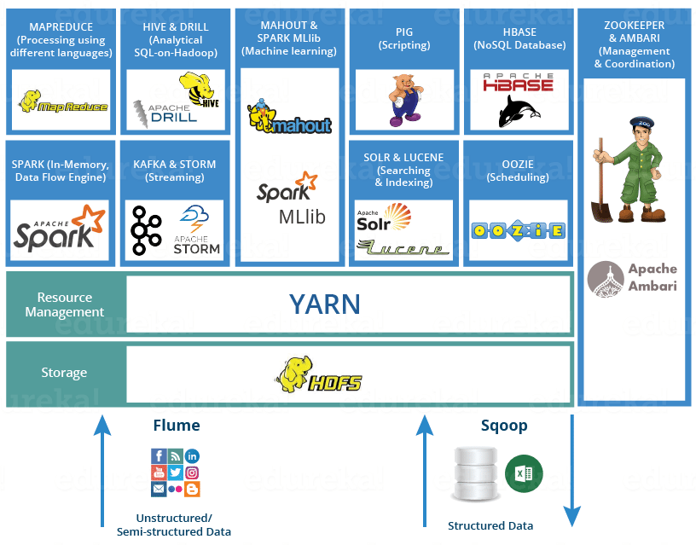
Hadoop Ecosystem
Big Data Analytics
FDP

Slide 35
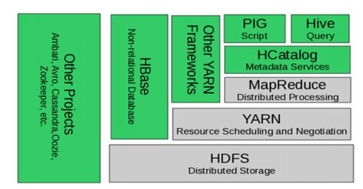
Hadoop Ecosystem
Big Data Analytics
FDP

Slide 36
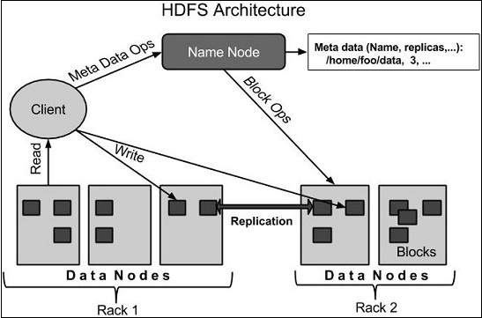
HDFS Architecture
Big Data Analytics
FDP

Slide 37
YARN
YARN – Yet Another Resource Manager.
Apache Hadoop YARN is the resource management and job scheduling technology in the open source Hadoop distributed processing framework.
YARN is responsible for allocating system resources to the various applications running in a Hadoop cluster and scheduling tasks to be executed on different cluster nodes.
Big Data Analytics
FDP

Slide 38
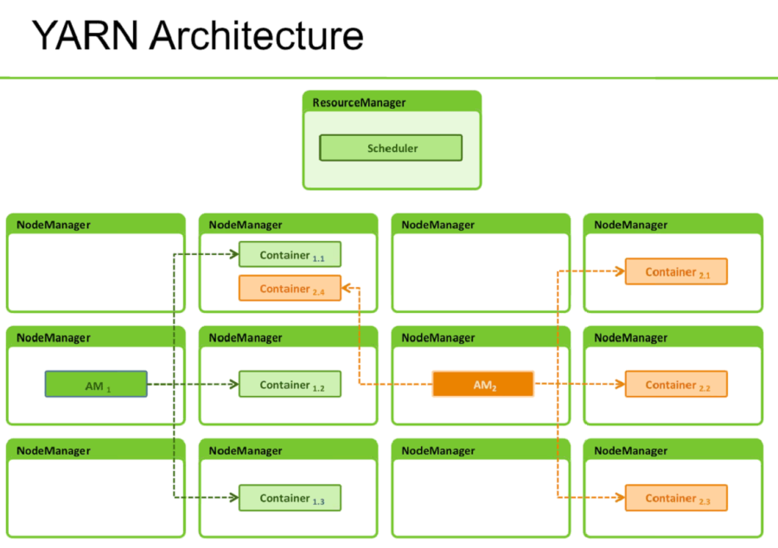
YARN
Big Data Analytics
FDP

Slide 39
Map Reduce
MapReduce is a programming model and an associated implementation for processing and generating large data sets.
Users specify a map function that processes a key/value pair to generate a set of intermediate key/value pairs, and a reduce function that merges all intermediate values associated with the same intermediate key
Big Data Analytics
FDP

Slide 40
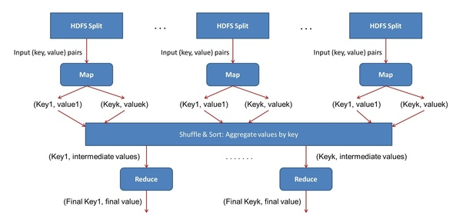
Map Reduce
Big Data Analytics
FDP

Slide 41
NoSQL
While the traditional SQL can be effectively used to handle large amount of structured data, we need NoSQL (Not Only SQL) to handle unstructured data.
NoSQL databases store unstructured data with no particular schema
Each row can have its own set of column values. NoSQL gives better performance in storing massive amount of data.
Big Data Analytics
FDP

Slide 42
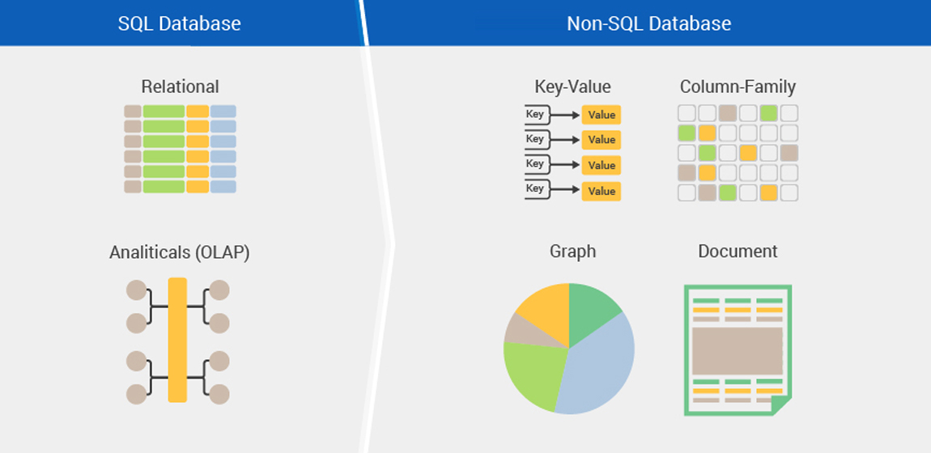
NoSQL
Big Data Analytics
FDP

Slide 43
Hive
This is a distributed data management for Hadoop.
This supports SQL-like query option HiveSQL (HSQL) to access big data.
This can be primarily used for Data mining purpose. This runs on top of Hadoop.
Big Data Analytics
FDP

Slide 44
Apache Spark
Apache Spark is a big data analytics framework that was originally developed at the University of California, Berkeley's AMPLab, in 2012. Since then, it has gained a lot of attraction both in academia and in industry.
Apache Spark is a lightning-fast cluster computing technology, designed for fast computation.
Apache Spark is a lightning-fast cluster computing technology, designed for fast computation
Big Data Analytics
FDP

Slide 45
Cassandra
Apache Cassandra is highly scalable, distributed and high-performance NoSQL database. Cassandra is designed to handle a huge amount of data.
Cassandra handles the huge amount of data with its distributed architecture.
Data is placed on different machines with more than one replication factor that provides high availability and no single point of failure.
Big Data Analytics
FDP

Slide 46
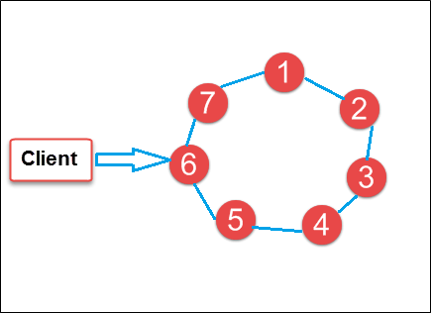
Cassandra
In the image above, circles are Cassandra nodes and lines between the circles shows distributed architecture, while the client is sending data to the node
Big Data Analytics
FDP

Slide 47
HBase
HBase is an open source, distributed database, developed by Apache Software foundation.
Initially, it was Google Big Table, afterwards it was re-named as HBase and is primarily written in Java.
HBase can store massive amounts of data from terabytes to petabytes.
Big Data Analytics
FDP

Slide 48
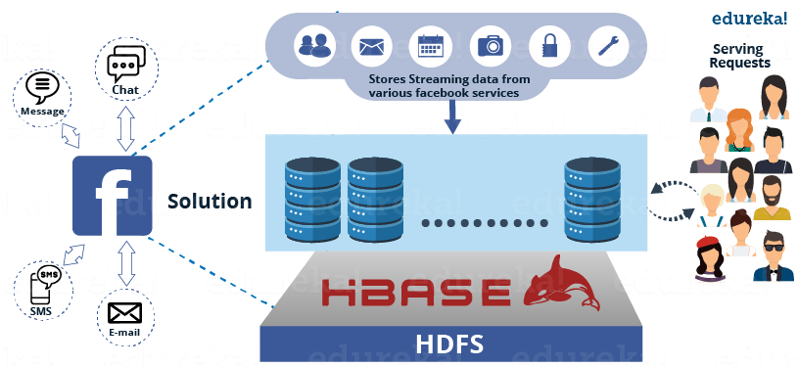
HBase
Big Data Analytics
FDP

Slide 49
Spark Streaming
Spark Streaming is an extension of the core Spark API that enables scalable, high-throughput, fault-tolerant stream processing of live data streams.
Streaming data input from HDFS, Kafka, Flume, TCP sockets, Kinesis, etc.
Spark ML (Machine Learning) functions and GraphX graph processing algorithms are fully applicable to streaming data .
Big Data Analytics
FDP

Slide 50
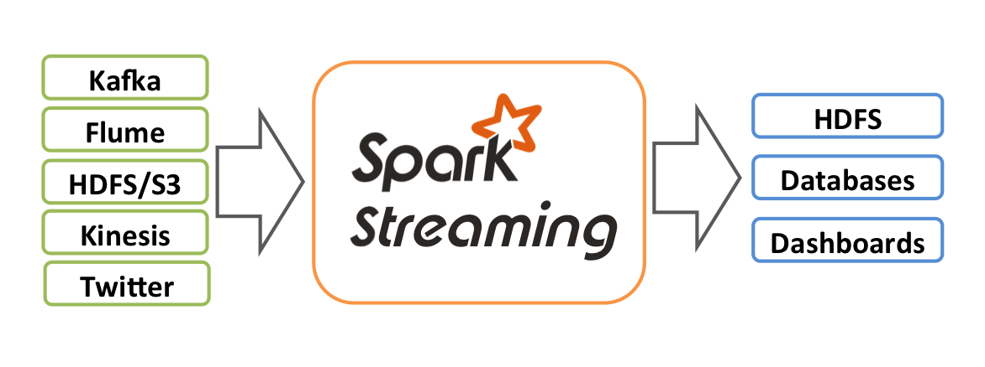
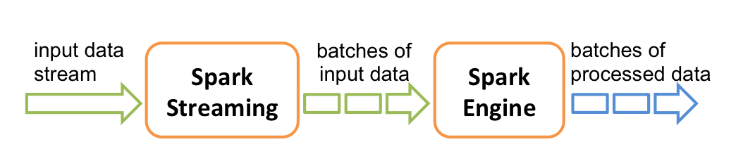
Spark Streaming
Big Data Analytics
FDP

Slide 51
Spark MLlib
Spark MLlib is a distributed machine-learning framework on top of Spark Core.
MLlib is Spark's scalable machine learning library consisting of common learning algorithms and utilities, including classification, regression, clustering, collaborative filtering, dimensionality reduction.
Big Data Analytics
FDP

Slide 52
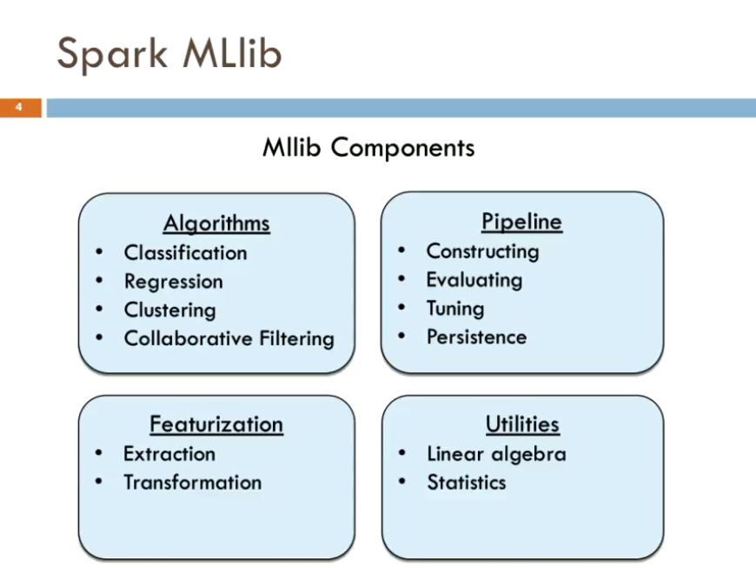
Spark Mllib Component
Big Data Analytics
FDP

Slide 53
Spark GraphX
GraphX is a new component in Spark for graphs and graph-parallel computation. At a high level, GraphX extends the Spark RDD by introducing a new graph abstraction.
GraphX reuses Spark RDD concept, simplifies graph analytics tasks, provides the ability to make operations on a directed multigraph with properties attached to each vertex and edge.
Big Data Analytics
FDP

Slide 54
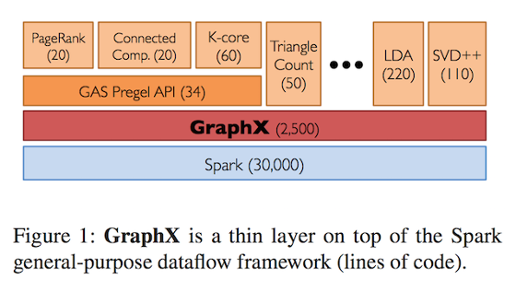
Spark GraphX
Big Data Analytics
FDP

Slide 55
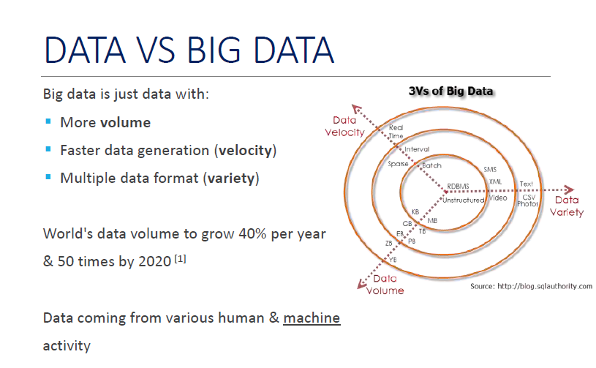

Slide 56
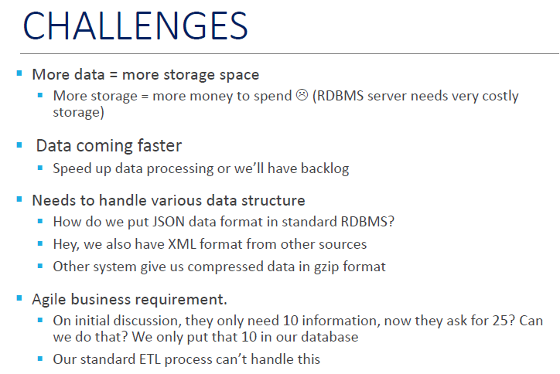

Slide 57
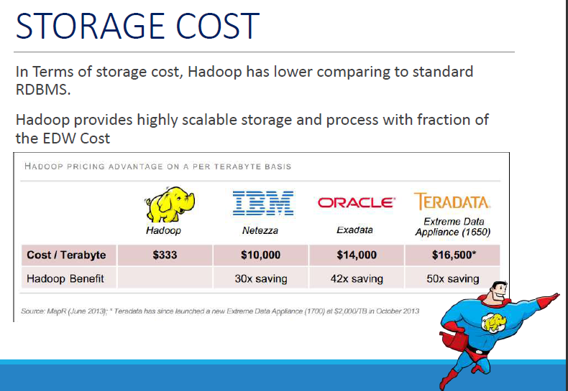

Slide 58
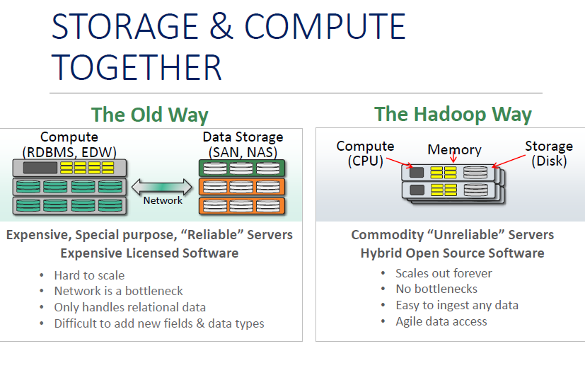

Slide 59
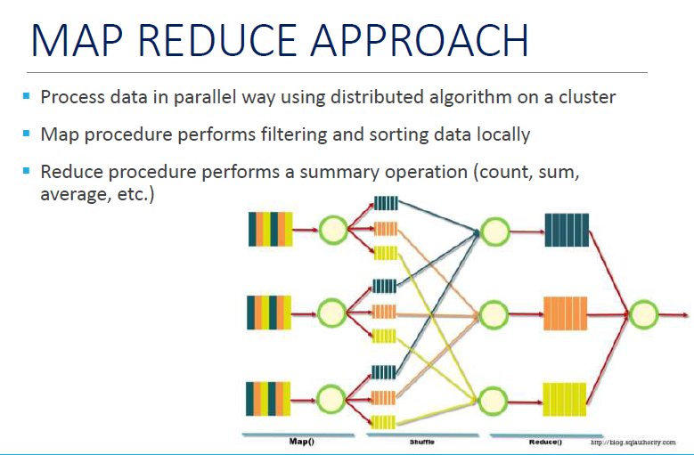

Slide 60
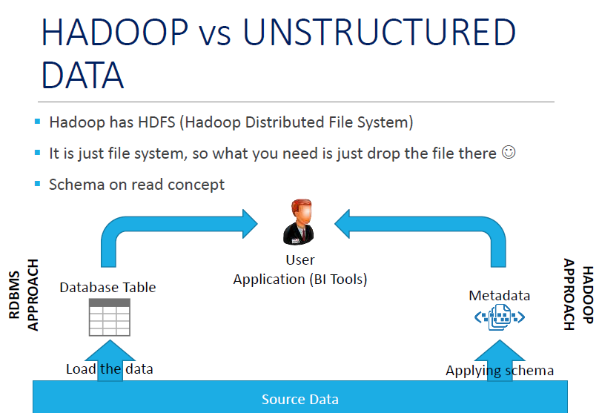

Slide 61
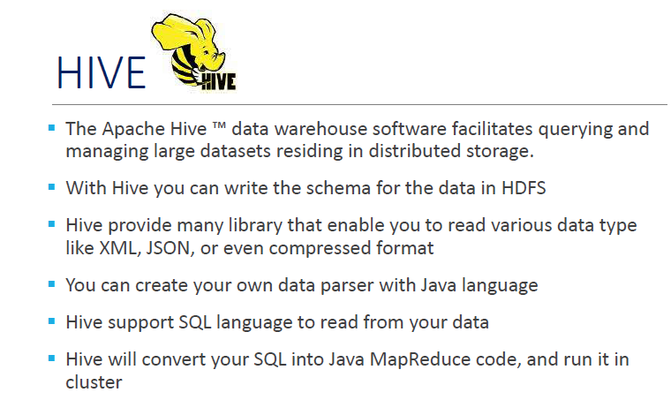

Slide 62
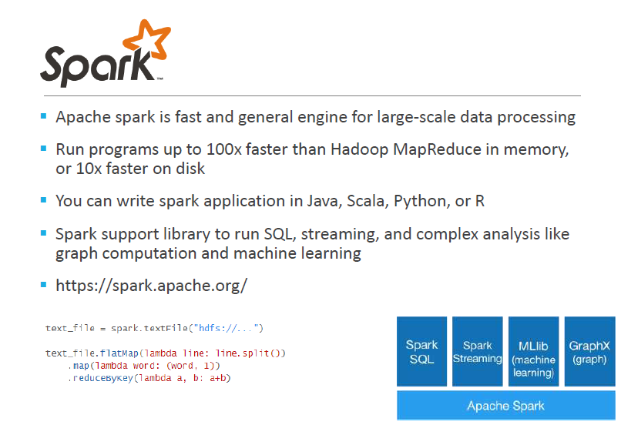

Slide 63
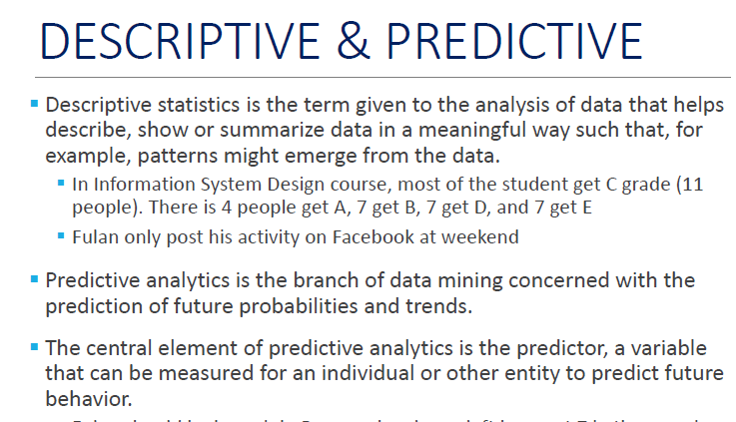
ANALYTICS

Slide 64
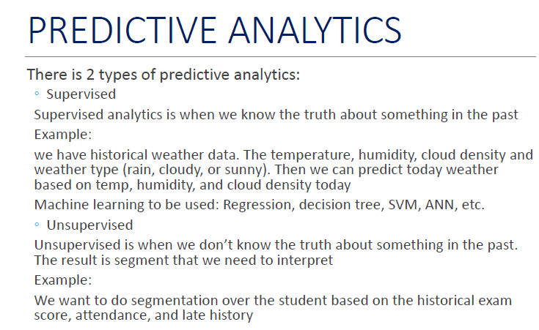

Slide 65
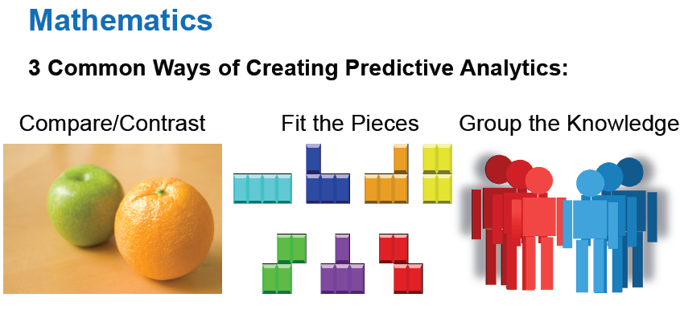

Slide 66
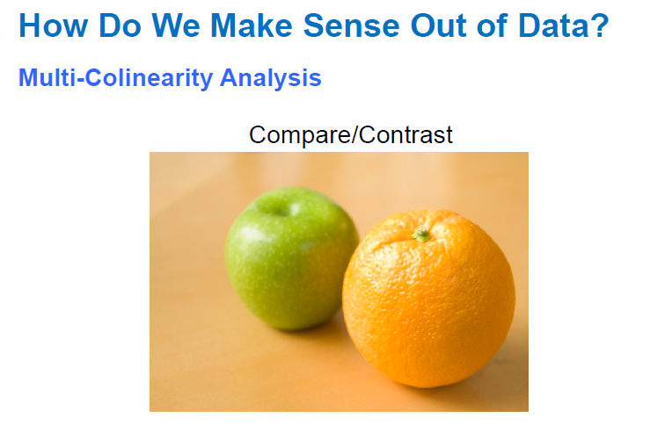

Slide 67
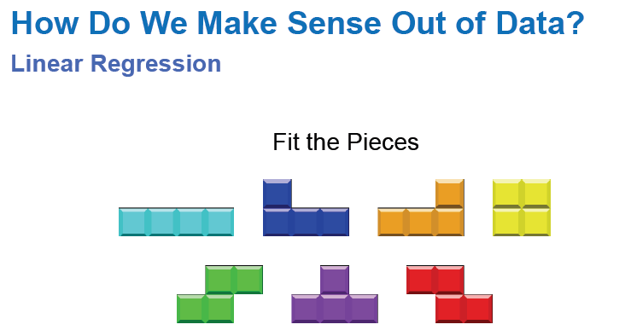

Slide 68
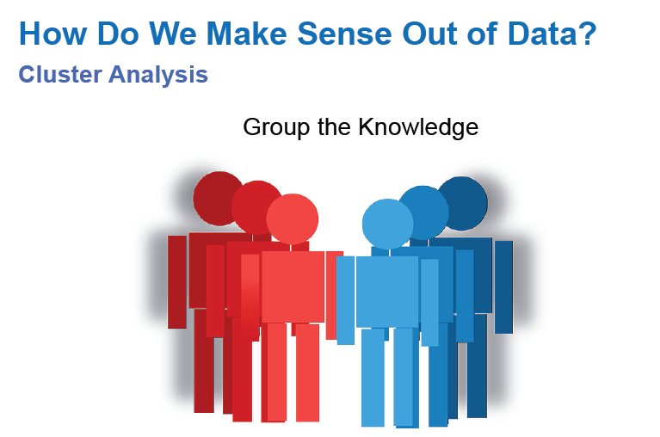

Slide 69
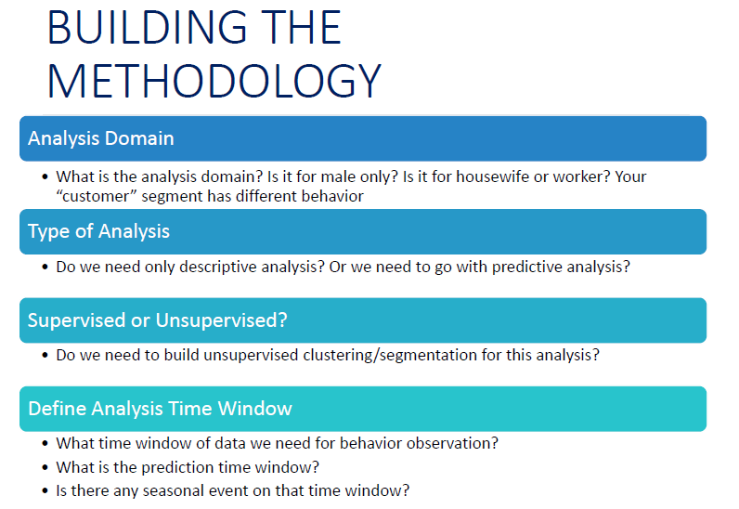

Slide 70
Hadoop HDFS
Dr. Rajiv Misra
Associate Professor
Dept. of Computer Science & Engg.
Indian Institute of Technology Patna
rajivm@iitp.ac.in
Big Data Analytics
FDP

Slide 71
Hadoop HDFS
Hadoop distributed File System (based on Google File System (GFS) paper, 2004)
Serves as the distributed file system for most tools in the Hadoop ecosystem
Scalability for large data sets
Reliability to cope with hardware failures
HDFS good for:
Large files
Streaming data
Not good for:
Lots of small files
Random access to files
Low latency access
Big Data Analytics
FDP

Slide 72
Design of Hadoop Distributed title System(HDFS)
Master-Slave design
Master Node
Single NameNode for managing metadata
Slave Nodes
Multiple DataNodes for storing data
Other
Secondary NameNode as a backup
Big Data Analytics
FDP

Slide 73
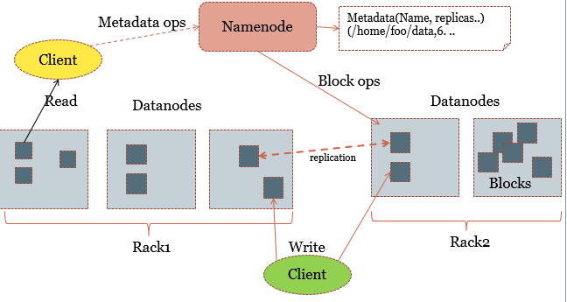
HDFS Architecture
NameNode keeps the metadata, the name, location and directory . DataNode provide storage for blocks of data
Big Data Analytics
FDP

Slide 74
File system Namespace
Hierarchical file system with directories and files
Create, remove, move, rename etc.
Namenode maintains the file system
Any meta information changes to the file system recorded by the Namenode.
An application can specify the number of replicas of the file needed: replication factor of the file. This information is stored in the Namenode.
Big Data Analytics
FDP

Slide 75
Namenode
Master
Manages filesystem namespace
Maintains filesystem tree and metadata-persistently on two files-namespace image and editlog
Stores locations of blocks-but not persistently
Metadata – inode data and the list of blocks of each file
Big Data Analytics
FDP

Slide 76
Datanodes
Workhorses of the filesystem
Store and retrieve blocks
Send blockreports to Namenode
Do not use data protection mechanisms like RAID…use replication
Startup-handshake:
Namespace ID
Software version
After handshake:
Registration
Storage ID
Block Report
Heartbeats
Big Data Analytics
Big Data Computing-A practical approach
FDP

Slide 77
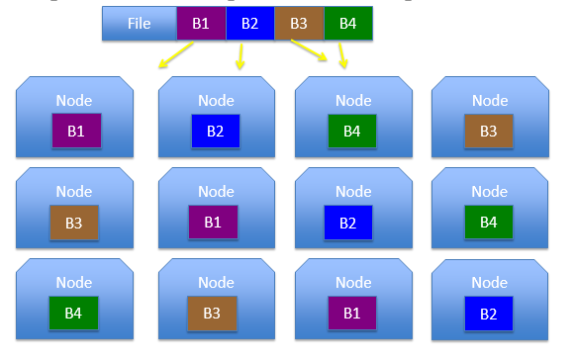
if node(s) fail?
Replication of Blocks for fault tolerance
Big Data Analytics
FDP

Slide 78
Secondary Namenode
If namenode fails, the filesystem cannot be used
Two ways to make it resilient to failure:
Backup of files
Secondary Namenode
Periodically merge namespace image with editlog
Runs on separate physical machine
Big Data Analytics
FDP

Slide 79
Secondary Namenode
Has a copy of metadata, which can be used to reconstruct state of the namenode
Disadvantage: state lags that of the primary namenode
Renamed as CheckpointNode (CN) in 0.21 release[1]
Periodic and is not continuous
If the NameNode dies, it does not take over the responsibilities of the NN
Big Data Analytics
FDP

Slide 80
MapReduce
Dr. Rajiv Misra
Associate Professor
Dept. of Computer Science & Engg.
Indian Institute of Technology Patna
rajivm@iitp.ac.in
Big Data Analytics
FDP

Slide 81
Introduction
MapReduce is a programming model and an associated implementation for processing and generating large data sets.
Users specify a map function that processes a key/value pair to generate a set of intermediate key/value pairs, and a reduce function that merges all intermediate values associated with the same intermediate key.
Many real world tasks are expressible in this model.
Big Data Analytics
FDP

Slide 82
Contd…
Programs written in this functional style are automatically parallelized and executed on a large cluster of commodity machines.
The run-time system takes care of the details of partitioning the input data, scheduling the program's execution across a set of machines, handling machine failures, and managing the required inter-machine communication.
This allows programmers without any experience with parallel and distributed systems to easily utilize the resources of a large distributed system.
A typical MapReduce computation processes many terabytes of data on thousands of machines. Hundreds of MapReduce programs have been implemented and upwards of one thousand MapReduce jobs are executed on Google's clusters every day.
Big Data Analytics
FDP

Slide 83
Distributed File System
Chunk Servers
File is split into contiguous chunks
Typically each chunk is 16-64MB
Each chunk replicated (usually 2x or 3x)
Try to keep replicas in different racks
Master node
Also known as Name Nodes in HDFS
Stores metadata
Might be replicated
Client library for file access
Talks to master to find chunk servers
Connects directly to chunk servers to access data
Big Data Analytics
FDP
Notes:
Worker nodes communicate with the Master through client libraries
Data organization, duplications, and scheduling details transparent to clients

Slide 84
Motivation for Map Reduce (Why)
Large-Scale Data Processing
Want to use 1000s of CPUs
But don’t want hassle of managing things
MapReduce Architecture provides
Automatic parallelization & distribution
Fault tolerance
I/O scheduling
Monitoring & status updates
Big Data Analytics
FDP

Slide 85
What is MapReduce?
Terms are borrowed from Functional Language (e.g., Lisp)
Sum of squares:
(map square ‘(1 2 3 4))
Output: (1 4 9 16)
[processes each record sequentially and independently]
(reduce + ‘(1 4 9 16))
(+ 16 (+ 9 (+ 4 1) ) )
Output: 30
[processes set of all records in batches]
Let’s consider a sample application: Wordcount
You are given a huge dataset (e.g., Wikipedia dump or all of Shakespeare’s works) and asked to list the count for each of the words in each of the documents therein
Big Data Analytics
FDP

Slide 86
Map
Process individual records to generate intermediate key/value pairs.
Key
Value
Welcome Everyone
Hello Everyone
Welcome 1
Everyone 1
Hello 1
Everyone 1
Input <filename, file text>
Big Data Analytics
FDP

Slide 87
Map
Parallelly Process individual records to generate intermediate key/value pairs.
MAP TASK 1
Welcome Everyone
Hello Everyone
Welcome 1
Everyone 1
Hello 1
Everyone 1
Input <filename, file text>
MAP TASK 2
Big Data Analytics
FDP

Slide 88
Map
Parallelly Process a large number of individual records to generate intermediate key/value pairs.
Welcome Everyone
Hello Everyone
Why are you here
I am also here
They are also here
Yes, it’s THEM!
The same people we were thinking of
…….
Welcome 1
Everyone 1
Hello 1
Everyone 1
Why 1
Are 1
You 1
Here 1
…….
Input <filename, file text>
MAP TASKS
Big Data Analytics
FDP

Slide 89
Reduce
Reduce processes and merges all intermediate values associated per key
Key
Value
Welcome 1
Everyone 1
Hello 1
Everyone 1
Everyone 2
Hello 1
Welcome 1
Big Data Analytics
FDP

Slide 90
Reduce
Each key assigned to one Reduce
Parallelly Processes and merges all intermediate values by partitioning keys
Popular: Hash partitioning, i.e., key is assigned to
reduce # = hash(key)%number of reduce tasks
Welcome 1
Everyone 1
Hello 1
Everyone 1
Everyone 2
Hello 1
Welcome 1
REDUCE
TASK 1
REDUCE
TASK 2
Big Data Analytics
FDP

Slide 91
Programming Model
The computation takes a set of input key/value pairs, and produces a set of output key/value pairs.
The user of the Map Reduce library expresses the computation as two functions:
(i) The Map
(ii) The Reduce
Big Data Analytics
FDP

Slide 92
(i) Map Abstraction
Map, written by the user, takes an input pair and produces a set of intermediate key/value pairs.
The MapReduce library groups together all intermediate values associated with the same intermediate key ‘I’ and passes them to the Reduce function.
Big Data Analytics
FDP

Slide 93
(ii) Reduce Abstraction
The Reduce function, also written by the user, accepts an intermediate key ‘I’ and a set of values for that key.
It merges together these values to form a possibly smaller set of values.
Typically just zero or one output value is produced per Reduce invocation. The intermediate values are supplied to the user's reduce function via an iterator.
This allows us to handle lists of values that are too large to fit in memory.
Big Data Analytics
FDP

Slide 94
Map-Reduce Functions for Word Count
map(key, value):
// key: document name; value: text of document
for each word w in value:
emit(w, 1)
reduce(key, values):
// key: a word; values: an iterator over counts
result = 0
for each count v in values:
result += v
emit(key, result)
Big Data Analytics
FDP

Slide 95
Map-Reduce Functions
Input: a set of key/value pairs
User supplies two functions:
map(k,v) → list(k1,v1)
reduce(k1, list(v1)) → v2
(k1,v1) is an intermediate key/value pair
Output is the set of (k1,v2) pairs
Big Data Analytics
FDP

Slide 96
MapReduce Applications
Big Data Analytics
FDP

Slide 97
Applications
Here are a few simple applications of interesting programs that can be easily expressed as MapReduce computations.
Distributed Grep: The map function emits a line if it matches a supplied pattern. The reduce function is an identity function that just copies the supplied intermediate data to the output.
Count of URL Access Frequency: The map function processes logs of web page requests and outputs (URL; 1). The reduce function adds together all values for the same URL and emits a (URL; total count) pair.
ReverseWeb-Link Graph: The map function outputs (target; source) pairs for each link to a target URL found in a page named source. The reduce function concatenates the list of all source URLs associated with a given target URL and emits the pair: (target; list(source))
Big Data Analytics
FDP

Slide 98
Contd…
Term-Vector per Host: A term vector summarizes the most important words that occur in a document or a set of documents as a list of (word; frequency) pairs.
The map function emits a (hostname; term vector) pair for each input document (where the hostname is extracted from the URL of the document).
The reduce function is passed all per-document term vectors for a given host. It adds these term vectors together, throwing away infrequent terms, and then emits a final (hostname; term vector) pair
Big Data Analytics
FDP

Slide 99
Contd…
Inverted Index: The map function parses each document, and emits a sequence of (word; document ID) pairs. The reduce function accepts all pairs for a given word, sorts the corresponding document IDs and emits a (word; list(document ID)) pair. The set of all output pairs forms a simple inverted index. It is easy to augment this computation to keep track of word positions.
Distributed Sort: The map function extracts the key from each record, and emits a (key; record) pair. The reduce function emits all pairs unchanged.
Big Data Analytics
FDP

Slide 100
Conclusion
The MapReduce programming model has been successfully used at Google for many different purposes.
The model is easy to use, even for programmers without experience with parallel and distributed systems, since it hides the details of parallelization, fault-tolerance, locality optimization, and load balancing.
A large variety of problems are easily expressible as MapReduce computations.
For example, MapReduce is used for the generation of data for Google's production web search service, for sorting, for data mining, for machine learning, and many other systems.
Big Data Analytics
FDP

Slide 101
Conclusion
Mapreduce uses parallelization + aggregation to schedule applications across clusters
Need to deal with failure
Plenty of ongoing research work in scheduling and fault-tolerance for Mapreduce and Hadoop.
Cloud Computing and Distributed Systems
MapReduce

Slide 102
Big Data Storage Technologies
Big Data Analytics
FDP

Slide 103
BIG DATA STORAGE TECHNOLOGIES
Distributed File Systems: Example Hadoop Distributed File System. It is well suited for quickly ingesting data and bulk processing.
NoSQL Databases: Use data models that are outside the relational world.
NewSQL Databases: A modern form of relational databases that aim for comparable scalability as NoSQL databases
Big Data Querying Platforms: Technologies that provide query facades in front of big data stores such as distributed file systems or NoSQL databases.
Big Data Analytics
FDP

Slide 104
RDBMS TRANSACTION – ACID RULE
Atomic – All of the work in a transaction completes (commit) or none of it completes.
Consistent – A transaction transforms the database from one consistent state to another consistent state. Consistency is defined in terms of constraints.
Isolated – Modifications of data performed by a transaction must be independent of another transaction.
Durable – When the transaction is completed, effects of the modifications performed by the transaction must be permanent in the system.
Big Data Analytics
FDP

Slide 105
WHAT IS NOSQL?
NoSQL is a non-relational database management systems
Significantly different from traditional RDBMS
It is designed for distributed data stores for very large scale of data storing needs (for example Google or Facebook which collects terabits of data every day for their users)
These type of data storing may not require fixed schema, avoid join operations and typically scale horizontally.
Big Data Analytics
FDP

Slide 106
NOSQL
Stands for Not Only SQL
No declarative query language
No predefined schema
Key-Value pair storage, Column Store, Document Store, Graph databases
Eventual consistency rather ACID property
Unstructured and unpredictable data
CAP Theorem
Prioritizes high performance, high availability and scalability
Big Data Analytics
FDP

Slide 107
WHY NOSQL?
Data is becoming easier to access and capture
Personal user information, social graphs, geo location data, user-generated content and machine logging data are just a few examples where the data has been increasing exponentially
It is required to process huge amount of data for which SQL databases were never designed
NoSQL aims to handle these huge data properly
Big Data Analytics
FDP

Slide 108
WHEN TO USE NOSQL
Big amount of data
Lots of reads/writes
Economic
Flexible schema
No transactions needed
ACID is not important
No joins
Big Data Analytics
FDP

Slide 109
NOSQL: PROS/CONS
Advantages:
High scalability
Distributed Computing
Lower cost
Schema flexibility, semi-structure data
No complicated Relationships
Disadvantages
No standardization
Limited query capabilities (so far)
Eventual consistent is not intuitive to program for
Big Data Analytics
FDP

Slide 110
THE BASE
Almost the opposite of ACID.
The BASE acronym was defined by Eric Brewer, who is also known for formulating the CAP theorem.
A BASE system gives up on consistency.
Basically Available indicates that the system does guarantee availability, in terms of the CAP theorem.
Soft state indicates that the state of the system may change over time, even without input. This is because of the eventual consistency model.
Eventual consistency indicates that the system will become consistent over time, given that the system doesn't receive input during that time.
Big Data Analytics
FDP

Slide 111
NOSQL DATABASE TYPES
Document databases pair each key with a complex data structure known as a document. Eg. FirstName = “Rashmi”, LastName = “Taneja”, Address = “IIT Patna”, Spouse = [{Name: “Manoj”, Age: 30}]
Graph stores are used to store information about networks, such as social connections
In Key-value-store category of NoSQL database, a user can store data in schema-less way. A key may be strings, hashes, lists, sets, sorted sets and values are stored against these keys.
Wide column stores are optimized for queries over large datasets and store columns of data together instead of rows.
Big Data Analytics
FDP

Slide 112
NOSQL CATEGORIES
Four general types (most common categories) of NoSQL databases:
Key-value stores
Column-oriented
Graph
Document oriented
Big Data Analytics
FDP

Slide 113
KEY – VALUE STORES
Key-value stores are most basic types of NoSQL databases.
Designed to handle huge amounts of data.
Based on Amazon’s Dynamo paper.
Key value stores allow developer to store schema-less data.
In the key-value storage, database stores data as hash table where each key is unique and the value can be string, JSON (JavaScript Object Notation), BLOB (basic large object) etc.
A key may be strings, hashes, lists, sets, sorted sets and values are stored against these keys.
For example a key-value pair might consist of a key like "Name" that is associated with a value like "Robin".
Key-Value stores can be used as collections, dictionaries, associative arrays etc.
Key-Value stores follows the 'Availability' and 'Partition' aspects of CAP theorem.
Key-Values stores would work well for shopping cart contents, or individual values like colour schemes, a landing page URI, or a default account number.
Big Data Analytics
FDP

Slide 114
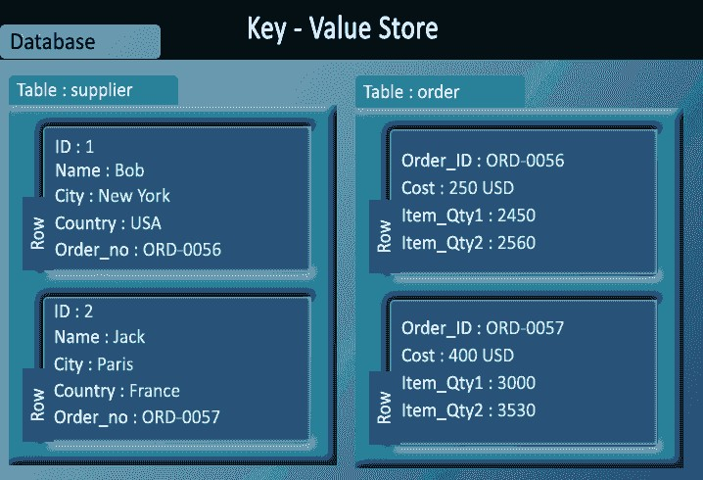
KEY – VALUE STORES
Example: Redis, Dynamo, Riak.
Big Data Analytics
FDP

Slide 115
COLUMN ORIENTED DATABASES
Work on columns and every column is treated individually.
Values of a single column are stored contiguously.
Column stores data in column specific files.
In Column stores, query processors work on columns too.
All data within each column have the same type which makes it ideal for compression.
Column stores can improve the performance of queries as it can access specific column data.
High performance on aggregation queries (e.g. COUNT, SUM, AVG, MIN, MAX).
Works on data warehouses and business intelligence, customer relationship management (CRM), Library card catalogs etc.
Big Data Analytics
FDP

Slide 116
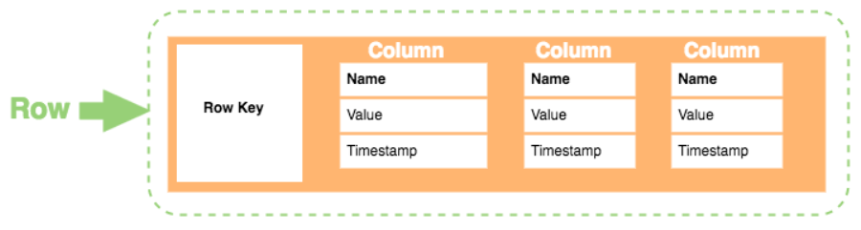
COLUMN ORIENTED DATABASES
Row Key. Each row has a unique key, which is a unique identifier for that row.
Column. Each column contains a name, a value, and timestamp.
Name. This is the name of the name/value pair.
Value. This is the value of the name/value pair.
Timestamp. This provides the date and time that the data was inserted.
This can be used to determine the most recent version of data.
Big Data Analytics
FDP

Slide 117
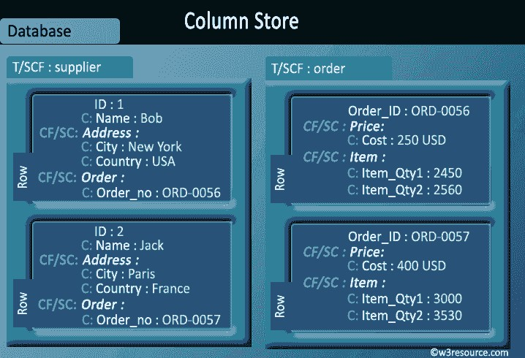
COLUMN ORIENTED DATABASES EXAMPLE
Examples: BigTable, Cassandra, SimpleDB
Big Data Analytics
FDP

Slide 118
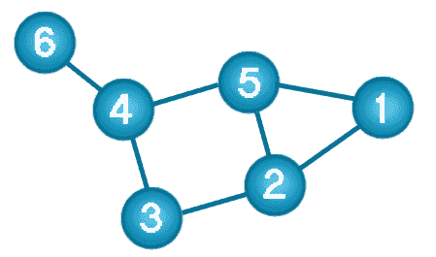
GRAPH DATABASES
A graph data structure consists of a finite (and possibly mutable) set of ordered pairs, called edges or arcs, of certain entities called nodes or vertices.
Big Data Analytics
FDP

Slide 119
GRAPH DATABASES
A graph database stores data in a graph.
It is capable of elegantly representing any kind of data in a highly accessible way.
A graph database is a collection of nodes and edges
Each node represents an entity (such as a student or business) and each edge represents a connection or relationship between two nodes.
Every node and edge is defined by a unique identifier.
Each node knows its adjacent nodes.
As the number of nodes increases, the cost of a local step (or hop) remains the same.
Index for lookups.
Big Data Analytics
FDP

Slide 120
COMPARISON BETWEEN RELATIONAL MODEL AND GRAPH MODEL
Relational Model | Graph Model
Tables | Vertices and Edges set
Rows | Vertices
Columns | Key/value pairs
Joins | Edges
Big Data Analytics
FDP

Slide 121
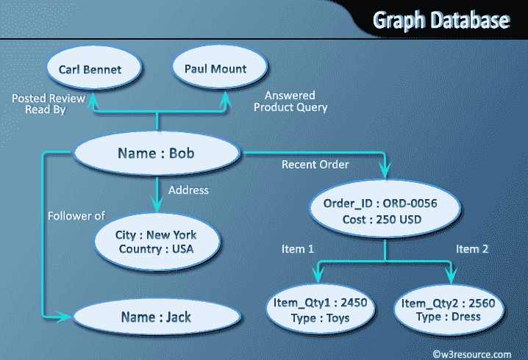
GRAPH DATABASES EXAMPLE
Example: OrientDB, Neo4J, Titan
Big Data Analytics
FDP

Slide 122
DOCUMENT ORIENTED DATABASES
A collection of documents
Data in this model is stored inside documents.
A document is a key value collection where the key allows access to its value.
Documents are not typically forced to have a schema and therefore are flexible and easy to change.
Documents are stored into collections in order to group different kinds of data.
Documents can contain many different key-value pairs, or key-array pairs, or even nested documents.
Big Data Analytics
FDP

Slide 123
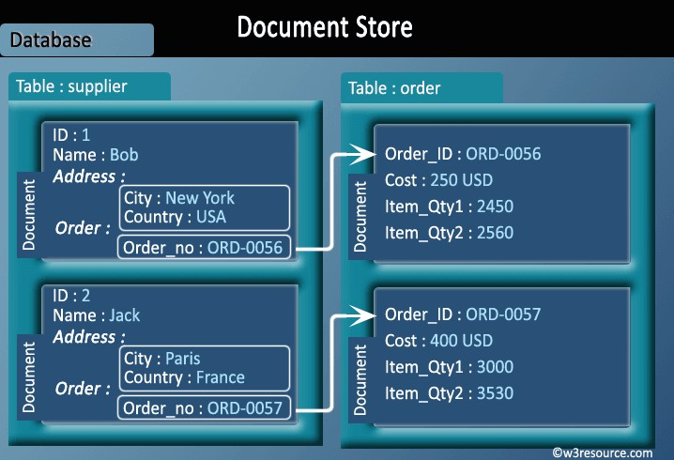
DOCUMENT ORIENTED DATABASES
 Example: MongoDB, CouchDB
Big Data Analytics
FDP

Slide 124
PRODUCTION DEPLOYMENT
There is a large number of companies using NoSQL.
Google
Facebook
Mozilla
Adobe
Foursquare
LinkedIn
Digg
McGraw-Hill Education
Vermont Public Radio
Big Data Analytics
FDP

Slide 125
NEWSQL
Is a term coined by 451 Group analyst Matt Aslett
Offers the best of both worlds:
Relational data model
ACID transactional consistency
Familiarity and interactivity of SQL
Scalability and speed of NoSQL
Example: VoltDB, NuoDB, MemSQL
Big Data Analytics
FDP

Slide 126
NEWSQL: WHAT IS NEW?
Main memory storage: reading and writing blocks to memory cache is much faster.
Historically memory was much more expensive and had a limited capacity compared to disks.
Now the scenario is different.
Many NewSQL DBMSs are based on this:
Academic (e.g., H-Store, HyPer)
Commercial (e.g., MemSQL, SAP HANA, VoltDB) systems
NewSQL systems evict a subset of the database out to persistent storage to reduce its memory footprint.
Big Data Analytics
FDP

Slide 127
CONCLUSION
Big data can be operational or analytical.
Two classes of technologies are complementary and frequently deployed together.
Big data storage technologies have grown in the following areas:
Distributed File Systems
NoSQL databases: complies BASE
NewSQL databases: complies ACID
Big Data Analytics
FDP

Slide 128
Introduction to Spark
Dr. Rajiv Misra
Associate Professor
Dept. of Computer Science & Engg.
Indian Institute of Technology Patna
rajivm@iitp.ac.in
Big Data Analytics
FDP

Slide 129
Need of Spark
Apache Spark is a big data analytics framework that was originally developed at the University of California, Berkeley's AMPLab, in 2012. Since then, it has gained a lot of attraction both in academia and in industry.
It is an another system for big data analytics
Isn’t MapReduce good enough?
Simplifies batch processing on large commodity clusters
Big Data Analytics
FDP

Slide 130
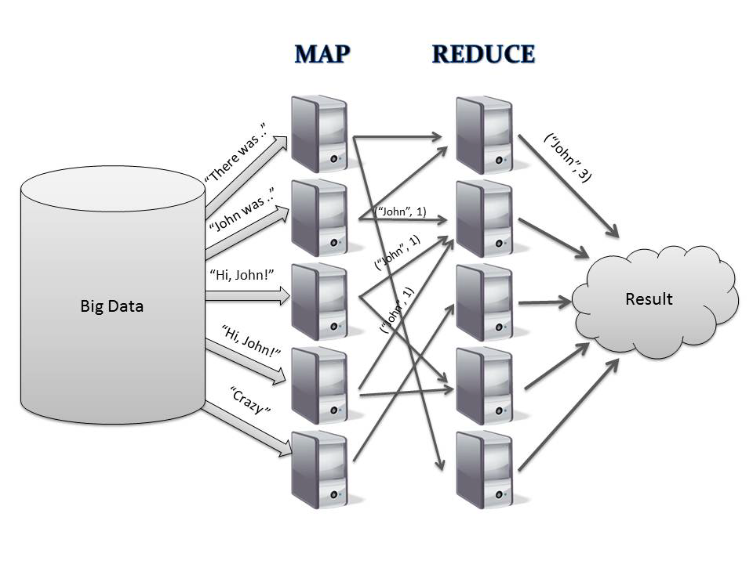
Need of Spark
Map
Reduce
Input
Output
Big Data Analytics
FDP

Slide 131
Need of Spark
Map
Reduce
Expensive save to disk for fault tolerance
Input
Output
Big Data Analytics
FDP

Slide 132
Need of Spark
MapReduce can be expensive for some applications e.g.,
Iterative
Interactive
Lacks efficient data sharing
Specialized frameworks did evolve for different programming
models
Bulk Synchronous Processing (Pregel)
Iterative MapReduce (Hadoop) ….
Big Data Analytics
FDP

Slide 133
Solution: Resilient Distributed Datasets (RDDs)
Resilient Distributed Datasets (RDDs)
Immutable, partitioned collection of records
Built through coarse grained transformations (map, join …)
Can be cached for efficient reuse
Big Data Analytics
FDP

Slide 134
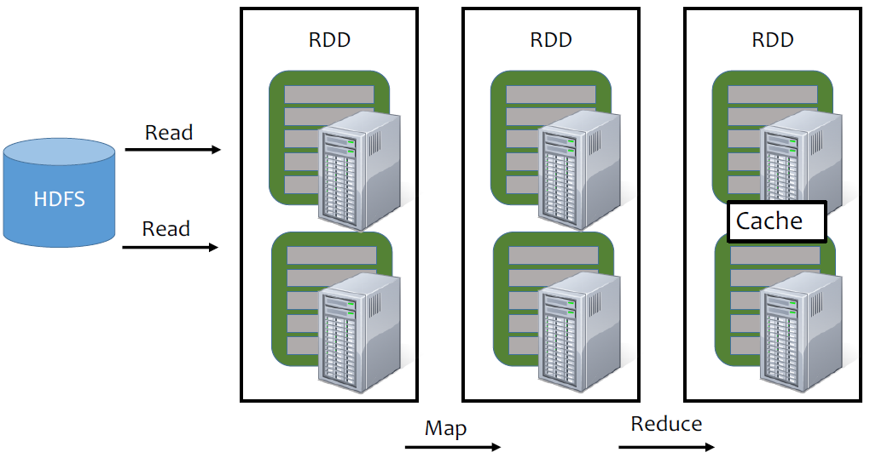
Need of Spark
RDD
RDD
RDD
Read
HDFS
Read
Cache
Map
Reduce
Big Data Analytics
FDP

Slide 135
Solution: Resilient Distributed Datasets (RDDs)
Resilient Distributed Datasets (RDDs)
Immutable, partitioned collection of records
Built through coarse grained transformations (map, join …)
Fault Recovery?
Lineage!
Log the coarse grained operation applied to a partitioned dataset
Simply recompute the lost partition if failure occurs!
No cost if no failure
Big Data Analytics
FDP

Slide 136
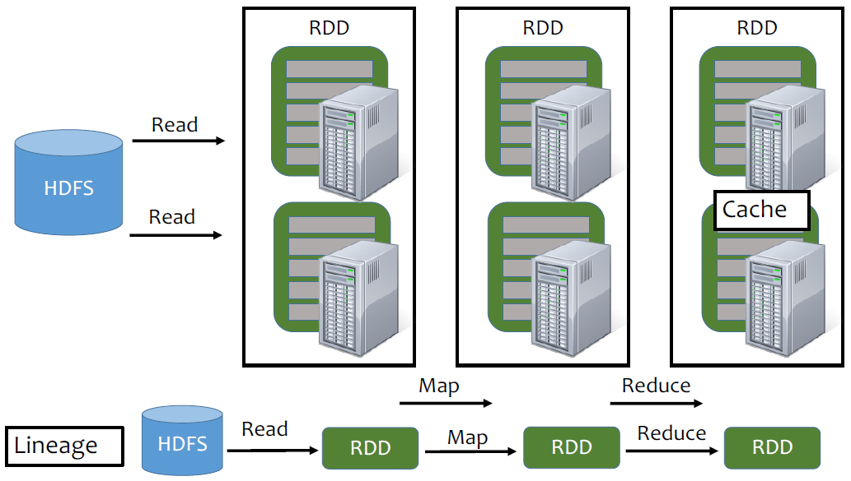
RDD
RDD
RDD
Read
HDFS
Read
Cache
Map
Reduce
Big Data Analytics
FDP

Slide 137
Read
Map
Reduce
Lineage
HDFS
Introduction to Spark
Big Data Analytics
FDP

Slide 138

RDD
RDD
RDD
Read
HDFS
RDDs track the graph of transformations that built them (their lineage) to rebuild lost data
Read
Cache
Map
Reduce
Big Data Analytics
FDP

Slide 139
What can you do with Spark?
RDD operations
Transformations e.g., filter, join, map, group-by …
Actions e.g., count, print …
Control
Partitioning: Spark also gives you control over how you can partition your RDDs.
Persistence: Allows you to choose whether you want to persist RDD onto disk or not.
Big Data Analytics
FDP

Slide 140

Partitioning: PageRank
Joins take place repeatedly
Good partitioning reduces shuffles
Big Data Analytics
FDP

Slide 141

Example: PageRank
Give pages ranks (scores) based on links to them
Links from many pages high rank
Links from a high-rank page high rank
Big Data Analytics
FDP

Slide 142

Algorithm
Step-1 Start each page at a rank of 1
Step-2 On each iteration, have page p contribute rankp/ |neighborsp| to its neighbors
Step-3 Set each page’s rank to 0.15 + 0.85 x contributions
Big Data Analytics
FDP

Slide 143

Algorithm
Step-1 Start each page at a rank of 1
Step-2 On each iteration, have page p contribute rankp/ |neighborsp| to its neighbors
Step-3 Set each page’s rank to 0.15 + 0.85 x contributions
Big Data Analytics
FDP

Slide 144

Algorithm
Step-1 Start each page at a rank of 1
Step-2 On each iteration, have page p contribute rankp/ |neighborsp| to its neighbors
Step-3 Set each page’s rank to 0.15 + 0.85 x contributions
Big Data Analytics
FDP

Slide 145

Algorithm
Step-1 Start each page at a rank of 1
Step-2 On each iteration, have page p contribute rankp/ |neighborsp| to its neighbors
Step-3 Set each page’s rank to 0.15 + 0.85 x contributions
Big Data Analytics
FDP

Slide 146

Algorithm
Step-1 Start each page at a rank of 1
Step-2 On each iteration, have page p contribute rankp/ |neighborsp| to its neighbors
Step-3 Set each page’s rank to 0.15 + 0.85 x contributions
Big Data Analytics
FDP

Slide 147
Spark Program
val links = // RDD of (url, neighbors) pairs
var ranks = // RDD of (url, rank) pairs
for (i <- 1 to ITERATIONS) {
val contribs = links.join(ranks).flatMap {
case (url, (links, rank)) =>
links.map(dest => (dest, rank/links.size))
}
ranks = contribs.reduceByKey (_ + _)
.mapValues (0.15 + 0.85 * _)
}
ranks.saveAsTextFile(...)
Big Data Analytics
FDP

Slide 148

PageRank Performance
Big Data Analytics
FDP

Slide 149

Generality
RDDs allow unification of different programming models
Stream Processing
Graph Processing
Machine Learning
Big Data Analytics
FDP

Slide 150
Big Data Analytics Spark Streaming
Big Data Analytics
FDP

Slide 151

What is Spark Streaming?
Receive data streams from input sources, process them in a cluster, push out to databases/ dashboards
Scalable, fault-tolerant, second-scale latencies
Big Data Analytics
FDP

Slide 152

Spark Streaming
Big Data Analytics
FDP

Slide 153
Spark Streaming
Spark Streaming Characteristics
Spark Streaming Characteristics
Extension to the Spark Core API
Live data streams can be processed
Fault-tolerant and scalable
High throughput (near) real-time data processing 3 0.5 s or longer
Streaming data input from HDFS, Kafka, Flume, TCP sockets, Kinesis, etc.
Big Data Analytics
FDP

Slide 154
Spark Streaming
Spark Streaming Characteristics
Stream processing high-level functions
Map, Reduce, Join, Window, etc.
Processed Output saved on Filesystems, Databases, and Live Dashboards
Spark ML (Machine Learning) functions and GraphX graph processing algorithms are fully applicable to streaming data
Big Data Analytics
FDP

Slide 155
Spark Streaming
Spark Streaming Characteristics
Spark uses (size controllable) micro-batch processing of data for real-time analysis
Hadoop uses batch processing of data, which is time consuming to obtain results
Spark uses RDD to arrange data and recover from failures
Big Data Analytics
FDP

Slide 156

Spark Streaming
Spark Streaming Input and Output
Big Data Analytics
FDP

Slide 157
Spark Streaming
Streaming Receiver Types
Basic
File systems
Socket connectors
Akka Actors
Sources directly available in Streaming Context API
Custom
Requires implementing a user-defined receiver
Anywhere
Advanced
Requires linking with systems that have extra dependencies.
Kafka,Flume,Twitter
Big Data Analytics
FDP

Slide 158
Spark Streaming
Spark Streaming process
Live input data stream received
Input data stream is divided into Mini-Batches called a DStream (Discretized Stream), which is saved as a small RDD every mini-batch perm.
Spark Stream engine cores process the mini batches and generate a final output stream of mini batches
Big Data Analytics
FDP

Slide 159
Spark Streaming
Dstream
Dstream (Discretized Stream) is a continuous stream of data with high-level abstraction
DStreams are created from input data stream sources (Kafka, Flume, Kinesis, etc.) or high-level processing operationon other DStreams
Big Data Analytics
FDP

Slide 160
Spark Streaming
Dstream
Dstreamsare represented as a sequence of small RDDs
Mini-Batch size is 0.5 s or longer
RDD is processed through the DAG
Processing latency (through the DAG) has to be smaller than the mini-batch period
Big Data Analytics
FDP

Slide 161

How does Spark Streaming work?
Chop up data streams into batches of few secs
Spark treats each batch of data as RDDs and processes them using RDD operations
Processed results are pushed out in batches
Big Data Analytics
FDP

Slide 162
Spark Streaming Programming Model
Discretized Stream (DStream)
Represents a stream of data
Implemented as a sequence of RDDs
DStreams API very similar to RDD API
Functional APIs in Scala, Java
Create input DStreams from different sources
Apply parallel operations
Big Data Analytics
FDP

Slide 163

Example – Get hashtags from Twitter
Example – Get hashtags from Twitter
Big Data Analytics
FDP
Big Data Computing
CS-555

Slide 164

Example – Get hashtags from Twitter
Big Data Analytics
FDP

Slide 165

Example – Get hashtags from Twitter
Big Data Analytics
FDP

Slide 166

Example – Get hashtags from Twitter
Big Data Analytics
FDP

Slide 167

Languages
Big Data Analytics
FDP

Slide 168

Window-based Transformations
Window Operations
Window Length
Number of blocks (partitions) to conduct a RDD DAG process together
Sliding Interval
Number of blocks (partitions) to slide the Window after a RDD process is conducted
Big Data Analytics
FDP

Slide 169
Window-based Transformations
Transformations for Windows
Key parameters: windowLength, slidelnterval
window( )
countByWindow( )
reduceByWindow ( ) IP
reduceByKeyAndWindow( )
countByValueAndWindow( )
etc.
Big Data Analytics
FDP

Slide 170

Window-based Transformations
Window Operations
If Window Length > Sliding Interval, then Overlap Blocks = (Window Length - Sliding Interval) will exist for each RDD process
Overlap Blocks help to analyze correlation (dependency) of sequential blocks of the streamed data.
Big Data Analytics
FDP

Slide 171

Window-based Transformations
Big Data Analytics
FDP

Slide 172

Spark Streaming
Spark Streaming Examples
IPTV or Web Page Live statistics
Channel or Page view of clicks
Use Kafka for buffering
Spark Streaming for processing
Draw a Heap Map of the current Channel or Page view clicks
Big Data Analytics
FDP

Slide 173



Spark Streaming
Spark Streaming Examples
Sales Product Type Monitoring
Online Sales
Read through Kafka
Department Store Sales
Read through Flume
Join 2 live data streams into Spark Streaming
Big Data Analytics
FDP

Slide 174

Spark Streaming
Big Data Analytics
FDP

Slide 175
Spark Streaming
One Stream Input (e.g., from kafka )
One Task slot in the Executor will serve as a Receiver (thread) to receive the live streaming data into a Block (Partition) of the RDD on the node
Receiver will also make a copy of this Partition to another node (e.g., replication factor 2)
DAG Transformations are executed on the new RDD
Big Data Analytics
FDP

Slide 176
Spark Streaming
Another Stream Added (e.g., from flume )
On a different node, assign one Task slot in the Executor to serve as a Receiver (thread) to receive the live streaming data into a Block (Partition) of the RDD on the node
Receiver will also make a copy of this Partition to another node ( e.g. Replication Factor 2)
Big Data Analytics
FDP

Slide 177

Spark Streaming
Another Stream Added (e.g., from flume)
DAG Transformations are executed on the new RDD
Union can be used to unify the two RDDs into one RDD
Big Data Analytics
FDP

Slide 178

Conclusion
Big Data Analytics
FDP

Slide 179
Machine Learning Using Spark
Big Data Analytics
FDP

Slide 180


What is Machine Learning ?
Science of how machines learn without being explicitly programmed.
Big Data Analytics
FDP

Slide 181

Machine Learning Use Cases
Big Data Analytics
FDP

Slide 182
What is ML Model ?
Mathematical formula with a number of parameters that need to be learned from the data. And fitting a model to the data is a process known as model training.
E.g. Linear Regression
Goal: fit a line y = mx + c to data points
After model training: y = 2x + 5
model
input
output
Big Data Analytics
FDP

Slide 183
Components Of Machine Learning
CLASSIFICATION
Logistic Regression
Naïve Bayes
Support Vector Machine(SVM)
Random Forest
COLLABORATIVE FILTERING
Alternating Least Squares(ALS)
REGRESSION
Linear regression
CLUSTERING
Kmeans , LDA
DIMENSIONALITY REDUCTION
Principal Component Analysis(PCA)
Big Data Analytics
FDP

Slide 184


Linear Regression Model Training
Linear regression is used to predict a quantitative response Y from the predictor variable X.
Linear Regression is made with an assumption that there’s a linear relationship between X and Y.
ONE FEATURE
Big Data Analytics
FDP

Slide 185

ML in SPARK
We have an utility in SPARK to implement machine learning called MLlib .
Big Data Analytics
FDP

Slide 186
Spark MLlib (Goals)
Practical machine learning is scalable and easy to use.
Simplify the development and deployment of scalable machine learning pipelines.
~75 organizations, ~200 individuals, ~20 companies.
Big Data Analytics
FDP

Slide 187
Spark MLlib Components
ALGORITHMS
Classification
Regression
Collaborative Filtering
Clustering
PIPELINE
Constructing
Evaluating
Tuning
Persistence
Big Data Analytics
FDP

Slide 188
Spark MLlib Components
UTILITIES
Linear Algebra
Statistics
FEATURIZATION
Extraction
Transformation
Big Data Analytics
FDP

Slide 189

Spark MLlib Pipeline
Big Data Analytics
FDP

Slide 190

Spark MLlib Pipeline Concepts
Big Data Analytics
FDP

Slide 191

Spark MLlib: Transformer
Preprocessing step of feature extraction.
Transforming data into consumable format.
Take input column, transform it to an output form.
Examples:-
Normalizes the data.
Tokenization – sentences into words.
Converting categorical values into numbers.
Big Data Analytics
FDP

Slide 192

Spark MLlib: Estimator
Another kind of Transformer.
Transform data by requiring two passes over data.
Learning algorithm that trains (fits) on data.
Return a model, which is a type of Transformer.
Examples:
LogisticRegression.fit() => LogisticRegressionModel
Big Data Analytics
FDP

Slide 193

Spark MLlib: Evaluator
Evaluate the model performance based certain metric.
ROC, RMSE
Help with automating the model tuning process.
Comparing model performance.
Select the best model for generating predictions.
Examples:
Binary Classification Evaluator, Cross Validator.
Big Data Analytics
FDP

Slide 194

Spark MLlib : Pipeline
To represent a ML workflow.
Consist of a set of stages.
Leverage the uniform API of Transformer & Estimator.
A type of Estimator - fit().
Can be persisted.
Big Data Analytics
FDP

Slide 195

Spark MLlib: Machine Learning Pipeline
Big Data Analytics
FDP

Slide 196

Spark ML Pipeline
Big Data Analytics
FDP

Slide 197

Spark MLlib : Pipeline Example in Scala
Big Data Analytics
FDP

Slide 198

Spark MLlib: Automatic model tuning
ParamGridBuilder
Cross Validator (k-fold)
Big Data Analytics
FDP

Slide 199
Exporting ML Models - PMML
Predictive Model Markup Language (PMML)
XML-based predictive model interchange format
Supported models
K-means
Linear Regression
Ridge Regression
Lasso
SVM
Binary
Big Data Analytics
FDP

Slide 200

Spark ML Pipeline – Sample Code
Big Data Analytics
FDP

Slide 201
Parameter Server
A machine learning framework
Distributes a model over multiple machines
Offers two operations:
Pull: query parts of the model
Push: update parts of the model
Machine learning update equation
(Stochastic) gradient descent
Collapsed Gibbs sampling for topic modeling
Aggregate push updates via addition (+)
Big Data Analytics
FDP

Slide 202

Parameter Server (PS)
Training state stored in PS shards, asynchronous updates.
Big Data Analytics
FDP

Slide 203
The GraphX API
Cloud Computing and Distributed Systems
Introduction to Spark

Slide 204



What is a Graph?
Graph: vertices connected by edges
Big Data Analytics
FDP

Slide 205
Graphs are Essential to Data Mining and Machine Learning
Identify influential entities (people, information…)
Find communities
Understand people’s shared interests
Model complex data dependencies
Big Data Analytics
FDP

Slide 206

Real World Graphs
Web pages
Big Data Analytics
FDP

Slide 207

Real World Graphs
Web pages
Big Data Analytics
FDP

Slide 208

Real World Graphs
Recommendation
Big Data Analytics
FDP

Slide 209

Real World Graphs
Credit card fraud detection
Big Data Analytics
FDP

Slide 210

Table and Graph Analytics
C
Big Data Analytics
FDP

Slide 211
Apache Spark GraphX
Spark component for graphs and graph- parallel computations
Combines data parallel and graph parallel processing in single API
View data as graphs and as collections (RDD)
no duplication or movement of data
Operations for graph computation
includes optimized version of Pregel
Provides graph algorithms and builders
Big Data Analytics
FDP

Slide 212

Property Graph
Big Data Analytics
FDP

Slide 213

Gather-Apply-Scatter on GraphX
Triplets
Graph Represented In a Table
Triplets
Big Data Analytics
FDP

Slide 214

Gather-Apply-Scatter on GraphX
Gather at A
Group-By A
Big Data Analytics
FDP

Slide 215

Gather-Apply-Scatter on GraphX
Apply
Map
Big Data Analytics
FDP

Slide 216

Gather-Apply-Scatter on GraphX
Scatter
Triplets
Join
Big Data Analytics
FDP

Slide 217

Graphs Property
Big Data Analytics
FDP

Slide 218

Creating a Graph (Scala)
Big Data Analytics
FDP

Slide 219

Graph Operations (Scala)
Big Data Analytics
FDP

Slide 220

Built-in Algorithms (Scala)
Big Data Analytics
FDP

Slide 221

The triplets view
Big Data Analytics
FDP

Slide 222

The subgraph transformation
Big Data Analytics
FDP

Slide 223

The subgraph transformation
Big Data Analytics
FDP

Slide 224

Computation with aggregateMessages
Big Data Analytics
FDP

Slide 225

Computation with aggregateMessages
Big Data Analytics
FDP

Slide 226

Example: Graph Coarsening
Big Data Analytics
FDP

Slide 227
How GraphX Works
Big Data Analytics
FDP

Slide 228

Storing Graphs as Tables
Big Data Analytics
FDP

Slide 229

Simple Operations
Reuse vertices or edges across multiple graphs
Big Data Analytics
FDP

Slide 230

Implementing triplets
Big Data Analytics
FDP

Slide 231

Implementing triplets
Big Data Analytics
FDP

Slide 232

Implementing aggregateMessages
Big Data Analytics
FDP

Slide 233
Future of GraphX
1. Language support
a) Java API
b) Python API: collaborating with Intel, SPARK-3789
2. More algorithms
a) LDA (topic modeling)
b) Correlation clustering
3. Research
a) Local graphs
b) Streaming/time-varying graphs
c) Graph database–like queries
Big Data Analytics
FDP

Slide 234
Other Spark Applications
Twitter spam classification
EM algorithm for traffic prediction
K-means clustering
Alternating Least Squares matrix factorization
In-memory OLAP aggregation on Hive data
SQL on Spark
Big Data Analytics
FDP

Slide 235
Thank You!
Big Data Analytics
Big Data Computing-A practical approach
FDP

Slide 236
References
https://www.crayondata.com/blog/top-big-data-technologies-used-store-analyse-data
https://www.guru99.com/cassandra-tutorial.html
Matei Zaharia, Mosharaf Chowdhury, Michael J. Franklin, Scott Shenker, Ion Stoica
“Spark: Cluster Computing with Working Sets”
Big Data Analytics
Big Data Computing-A practical approach
FDP

Slide 237
References
Matei Zaharia, Mosharaf Chowdhury et al.
“Resilient Distributed Datasets: A Fault-Tolerant Abstraction for In-Memory Cluster Computing”
https://spark.apache.org/
Jeffrey Dean and Sanjay Ghemawat,
“MapReduce: Simplified Data Processing on Large Clusters”
http://labs.google.com/papers/mapreduce.html
Big Data Analytics
Cloud Computing and Distributed Systems
FDP

